Slide 1
Hand Gesture to Text and Speech Convertor
Shri Shankaracharya Institute of Professional Management & Technology, Raipur
Major Project(Phase-I) Report on
CSE 7th Semester
Department of Computer Science and Engineering,
Batch 2019-2023
Session: July – Dec 2022
Presentation Date: 24/01/2023
Project Guide
Preeti Tuli
(Assistant Professor,Computer Science and Engineering Department)
Project Group Members:
Anjali Jha
Simran Banarase
Sudhanshu Shukla

Slide 2
Introduction about Project
Sign Language Recognition is one of the most growing fields of research area. Many newtechniques have been developed recently in this area. The Sign Language is mainly used forcommunication of deaf-dumb people. The proposed system contains four modules such as:pre-processing and hand segmentation, feature extraction, sign recognition and sign to text.
Pre-processing includes opening main file and getting into application interface. Gesture recognition is done when gesture is captured and compared to already present patterns in trained database , classified gesture is converted to text and subsequently to voice

Slide 3
Application Area
Why did you opt to work on this project?
The people can easily communicate with each other. The user-friendly nature of the system ensure that people can use it without any difficulty and complexity. The application is cost efficient and eliminates the usage of expensive technology and making environment more comfortable for impaired person to communicate.
What are the Applications and Benefits of this project?
The project gives us the many advantages of usage area of sign language.
After this system, it is an opportunity to use this type of system in any places such as schools, doctor offices, colleges, universities, airports, social services agencies, community service agencies and courts, briefly almost everywhere.
Who are the End Users of this project?
Impaired persons

Slide 4
Literature Review
A various hand gestures were recognized with different methods by different researchers inwhich were implemented in different fields. The recognition of various hand gestures weredone by different approaches like Artificial Neural Network and others like PCA, etc and recognition techniques are divided into three broad categories such as Hand segmentation approaches, Feature extraction approaches and Gesture recognition approaches. Data gloves and Vision based method are commonly used to interpret gestures for human computer interaction. The sensors attached to a glove that finger flexion into electrical signals for determining the hand posture in the data gloves method. The camera is used to capture the image gestures in the vision based method. The vision based method reduces the difficulties as in the glove based method.

Slide 5
Problem Identification
The problem statement centres around the concept of a camera-based sign language recognition system for the deaf, which would transform sign language gestures to text and subsequently text to speech. Our goal is to create a user-friendly and straightforward solution.
Dumb individuals communicate via hand signs, thus normal folks have a hard time understanding what they're saying. As a result, systems that recognise various signs and deliver information to ordinary people are required.

Slide 6
Methodology
Software Requirement:-
VS Code
Python
Module Requirement:-
NumPy
Open Cv
Tensorflow
Mediapipe
Keras
Hardware Requirement:-
Processors: i3,i5,i7 processor
Disk space: 1GB or space
Operating systems: Windows 7 or later, macOS, and Linux

Slide 7
Project Work Flow Diagram
Image Acquisition
from Camera
Hand Region
Segmentation
Hand Detection
Tracking
Display as Text
Classified
Gesture
Hand Posture
Recognition

Slide 8
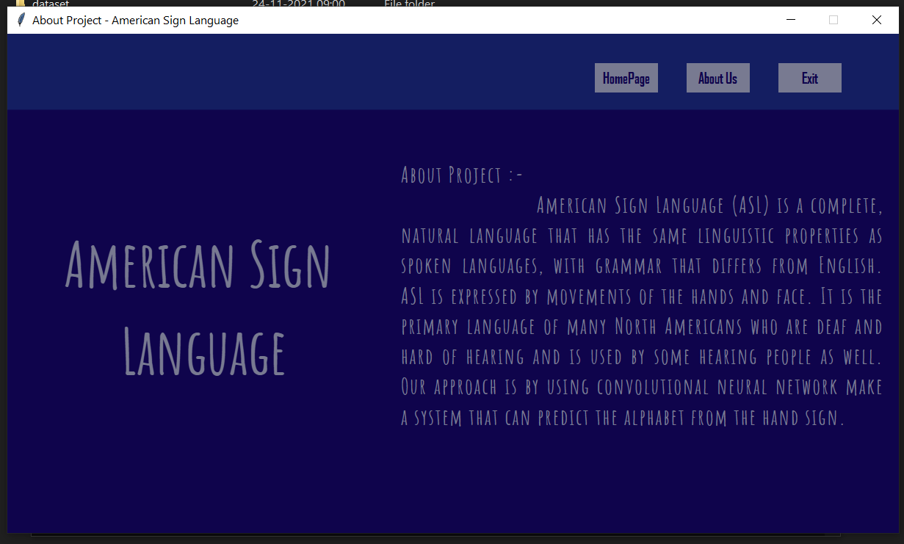
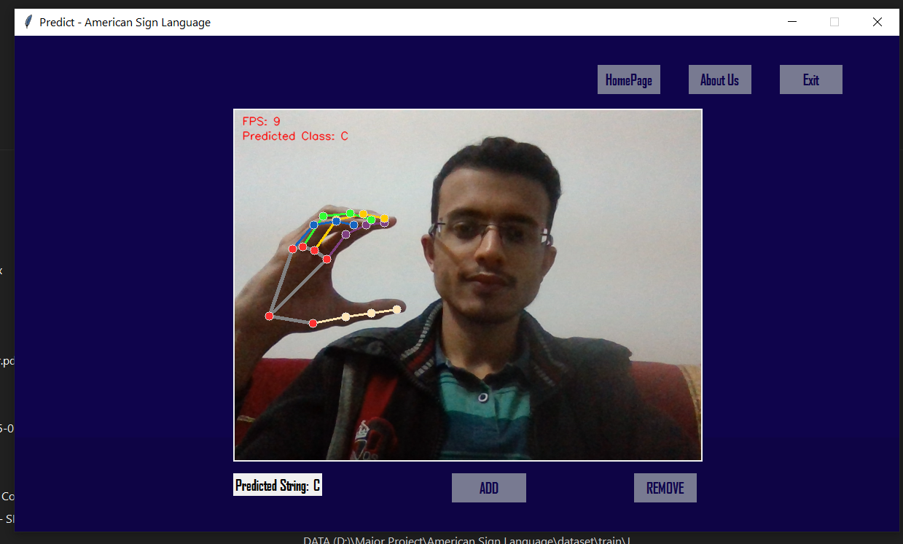
Result
Application Interface
Classifying Letter “C”

Slide 9
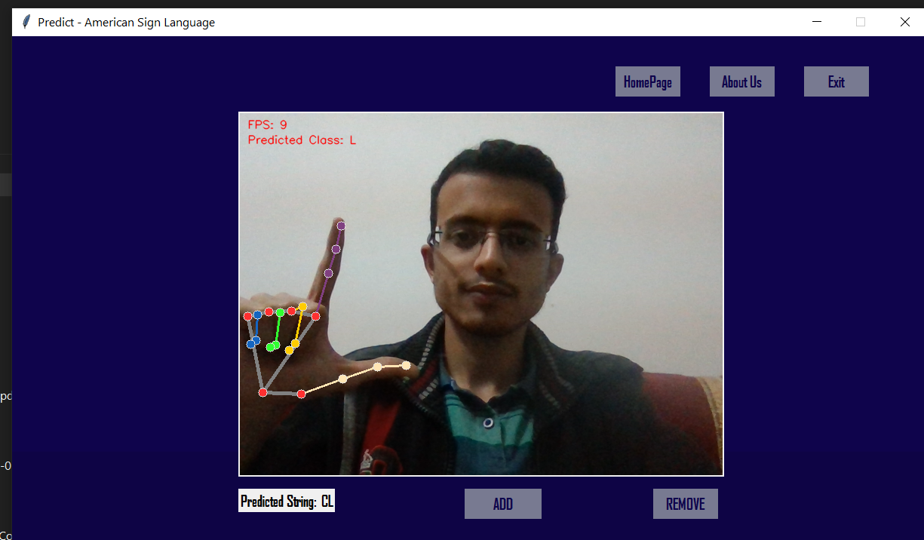
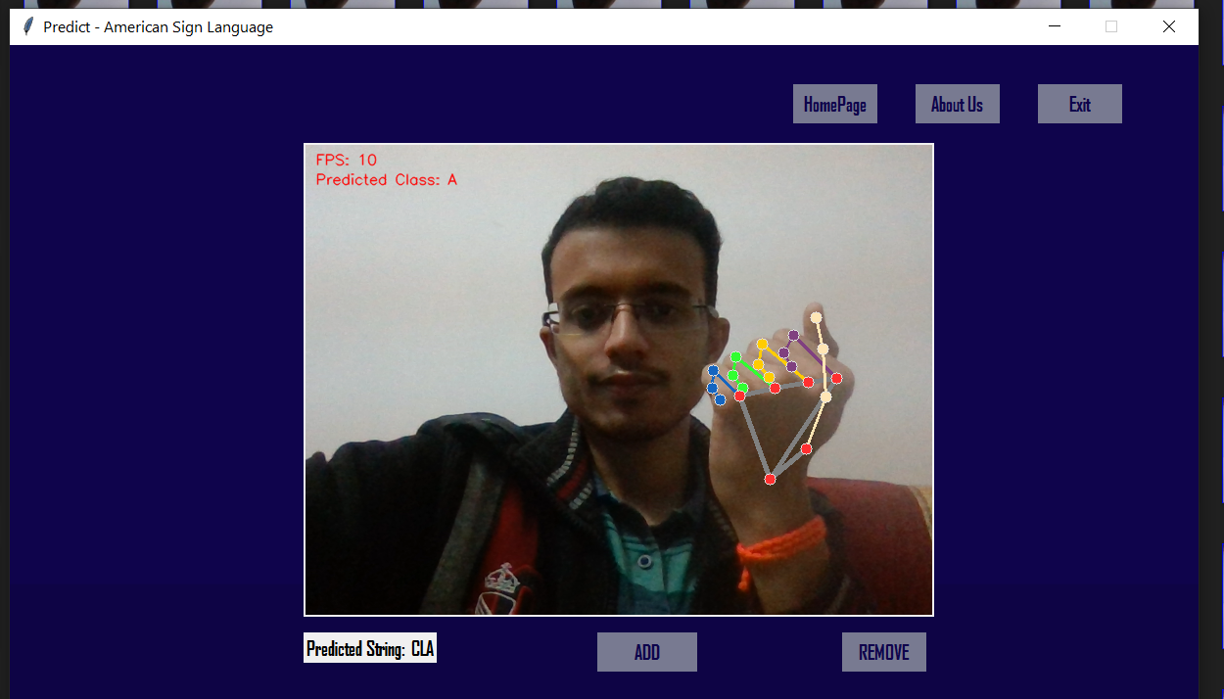
Result
Classifying Letter “L”
Classifying Letter “A”

Slide 10
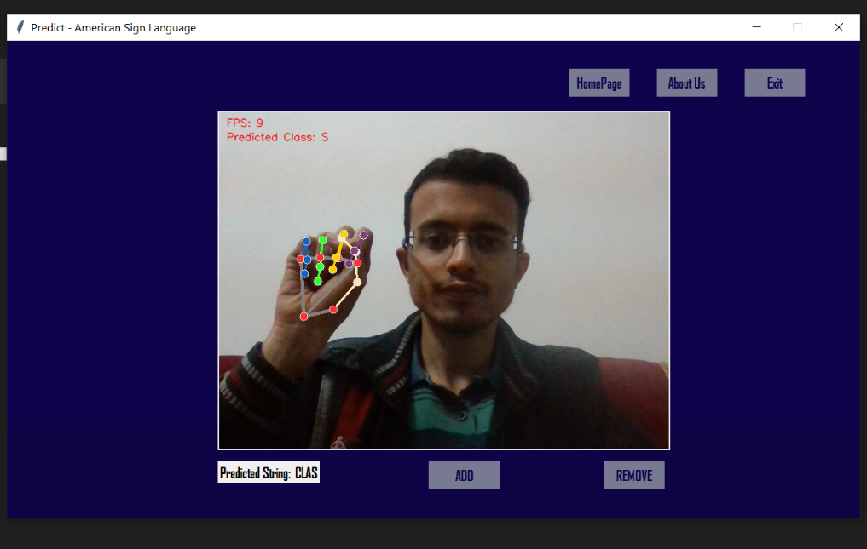
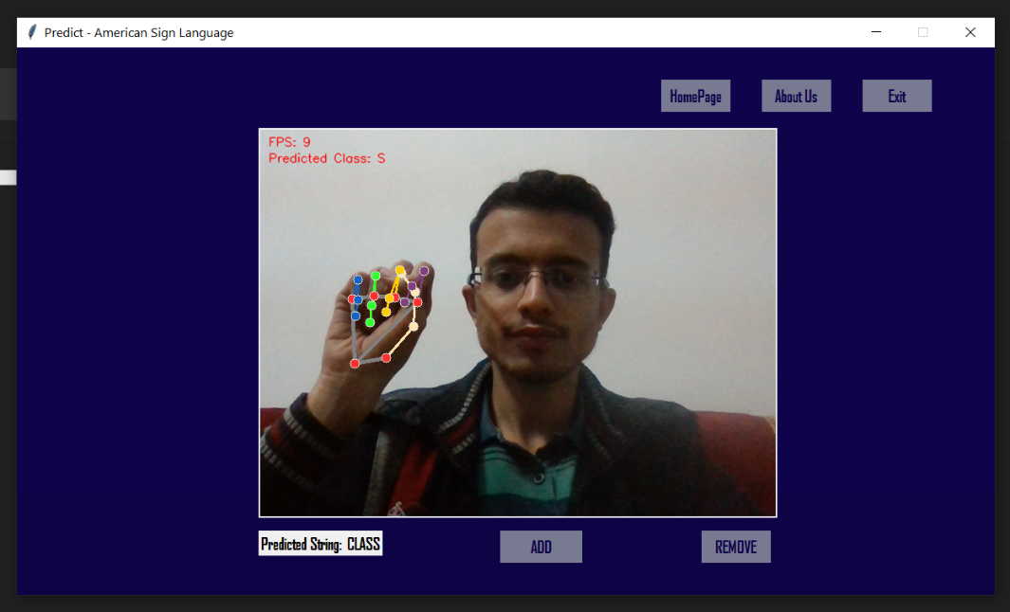
Result
Classifying Letter “S”
Classifying Letter “S”

Slide 11
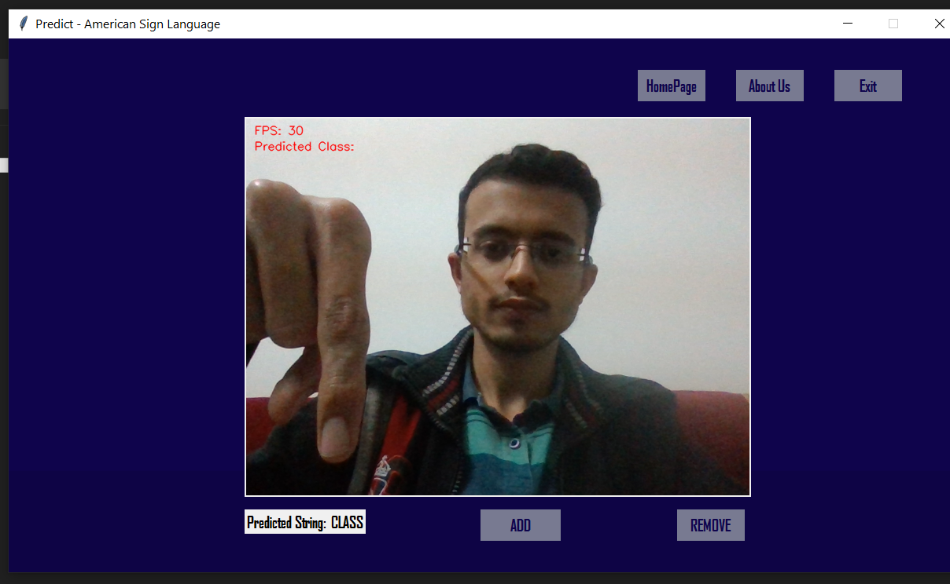
Result
Fig.4.7 Display the text “CLASS”

Slide 12
Conclusion
The practical adaption of the interface solution for visually impaired and blind people is limited by simplicity and usability in practical scenarios. As an easy and practical way to achieve human-computer- interaction, in this solution hand gesture to speech and text conversion has been used to facilitate the reduction of hardware components.
On the whole, the solution aims to provide aid to those in need thus ensuring social relevance. The people can easily communicate with each other. The user-friendly nature of the system ensure that people can use it without any difficulty and complexity. The application is cost efficient and eliminates the usage of expensive technology.

Slide 13
References
[1] J.P. Bonet. “Reducci_on de las letras y arte para ense~nar a hablar a los mudos”, Coleccion Cl_asicos Pepe. C.E.P.E., 1992.
[2] William C. Stokoe. Sign Language Structure [microform] / William C. Stokoe. Distributed by ERIC Clearinghouse, [Washington, D.C.], 1978.
[3] William C. Stokoe, Dorothy C Casterline, and Carl G Croneberg. “A Dictionary of American Sign Language on Linguistic Principles” Linstok Press, [Silver Spring, Md.], New Edition, 1976.
[4]Guo D, Zhou W, Wang M, Li H. Sign language recognition based on adaptive HMMS with data augmentation. Proceedings - International Conference on Image Processing, ICIP. 2016; 2016-Augus: p. 2876-2880

Slide 14
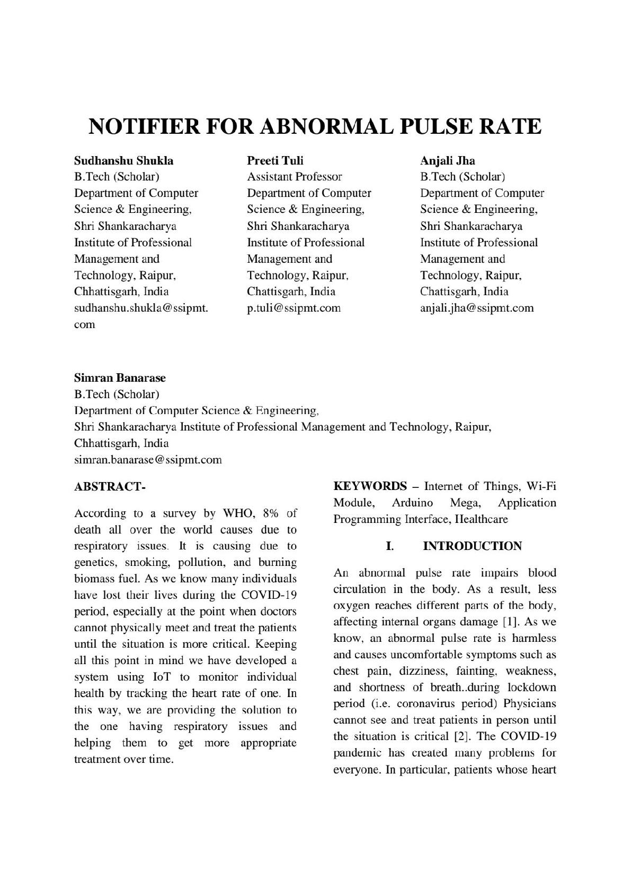
Paper Publication Details
13

